Slide 1
Data Communications
Chapter 5
Analog Transmission
Dr. Fayez Kiwan
5.<number>

Slide 2
Why Analog Transmission ?
When we have only band pass channels
How to transmit digital signals using analog transmission ?
In carrying the digital signal over an
analog one ➔ Modulation
Modulation ➔ Digital to Analog Conversion
D/A
5.<number>

Slide 3
DIGITAL-TO-ANALOG CONVERSION (D/A)
Digital-to-analog consists of changing one (or more) of the characteristics of an analog signal (Amplitude, Frequency, and Phase) based on the information in digital data.

Slide 4

Digital-to-analog conversion (D/A)
Modulator: conversion D/A
Demodulator: conversion A/D
5.<number>

Slide 5

Types of digital-to-analog conversion
5.<number>

Slide 6
Remember
Bit rate is the number of bits transmitted per second. Baud rate is the number of signal elements transmitted per second.
S = N/r
S<=N
5.<number>

Slide 7
Example
An analog signal carries 4 bits per signal element. If 1000 signal elements are sent per second, find the bit rate.
5.<number>

Slide 8
Types of Modulation
5.<number>

Slide 9
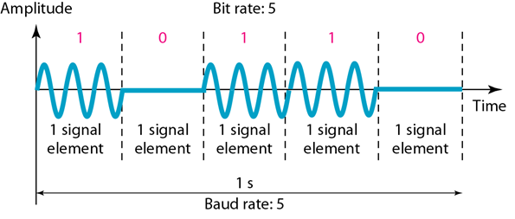
Amplitude shift keying (ASK=OOK)
continuous
Bandwidth Shape for nonperiodic signal ?
Bmin=S (digital transmission), for analog transmission B=S(1+d)
5.<number>

Slide 10
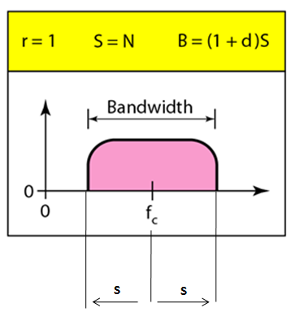
Where d is called “constant of modulation. Its value is between 0 and 1. Therefore the bandwidth of the modulated signal is located between a minimum value of “S” and a maximum value of “2S”.
How to arrange to pass this signal in a band pass channel?
5.<number>

Slide 11

Implementation of binary ASK
5.<number>

Slide 12
Example (ASK with d=1 and r=1)
A channel having a bandwidth of 100 kHz which spans from 200 to 300 kHz.
What is the carrier frequency?
What is the bit rate?
fc=250 kHz..
B =100 =S(1+d)=2S ➔ S=B/2= 50 Kbaud
N=S= 50 Kbps
5.<number>

Slide 13

Example
How to divide the previous 100 KHz (200-300 KHz) bandwidth to use the available channel as full duplex
5.<number>

Slide 14
Frequency shift keying (FSK)
5.<number>

Slide 15
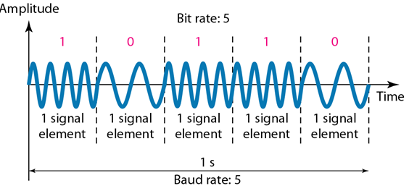
Frequency shift keying(FSK)
There are two nonperiodic signals. What is the shape of the bandwidth of the two mentioned signals
5.<number>

Slide 16
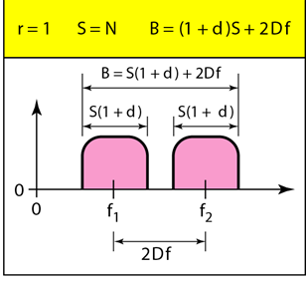
5.<number>

Slide 17
Example (FSK, r=1, d=1)
A channel having a bandwidth of B=100 kHz which spans from 200 to 300 kHz. Define N, f1, and f2.
Assumption
Midpoint of the band is 250 kHz. 2Δf =50 kHz
S=25 Kbaud N=25 Kbps
f1= 225 KHz f2=275 KHz
5.<number>

Slide 18
Phase shift keying (PSK)
5.<number>

Slide 19

Phase shift keying (PSK)
BPSK: Binary PSK is the simplest 0 and 180
5.<number>

Slide 20
Comparison
PSK as simple as ASK, both need one carrier
PSK is less susceptible to noise
FSK is relatively complex, it needs two carriers, larger bandwidth
5.<number>

Slide 21
QPSK (Quadrature phase shift keying)
Quadrature Phase Shift Keying employs shifting the phase of the carrier.
QPSK is used in almost all modems.
The data is encoded as follows:
Bits | Phase Shift
00 | +90
01 | 0
10 | 180
11 | 270
5.<number>

Slide 22
QAM = quadrature amplitude modulation
Quadrature amplitude modulation is a combination of ASK and PSK. So we have to modulate the carrier in amplitude , and in phase.
5.<number>

Slide 23
Basically there are two types of QAM:
8-QAM, and 16-QAM
8-QAM encodes 3 bits of data (2^3=8)
16-QAM encodes 4 bits of data (2^4=16).
Higher data rates use much more complex
QAM (32, 64, 128, 256).
5.<number>

Slide 24
5-2 ANALOG TO ANALOG
Analog-to-analog conversion is the representation of analog information by an analog signal. One may ask why we need to modulate an analog signal; it is already analog. Analog to analog conversion(modulation) is needed if the medium is bandpass in nature, and there a gap between the bandwidth of the signal, and the bandwidth of the channel

Slide 25
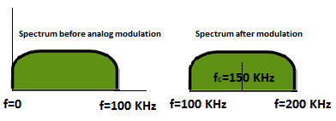
The main goal in analog modulation is to move the spectrum of the analog signal to fit in the available band of the channel available
5.<number>

Slide 26
Example:
We need to transmit two digital signals using two different speeds respectively: 5 Kbps, and 10 Kbps using two band pass channels:
1- compute the required bandwidth if we use FSK (without gap) to modulate the first signal, and PSK for the second (in assuming the value of d=1)
2- suppose we have a band pass channel [40-80]KHz
to transmit the two signals. Divide the available bandwidth and compute the carrier frequencies.
B1=2S+2df=4S=4N=20 KHz
B2=2S=2N=20 KHz
5.<number>

Slide 27

Types of analog-to-analog modulation(reading)
5.<number>

Slide 28

Amplitude modulation
5.<number>

Slide 29
Remember
The total bandwidth required for AM
can be determined
from the bandwidth of the audio
signal: B_{AM} = 2B.
5.<number>

Slide 30

AM band allocation
5.<number>

Slide 31

Frequency modulation
5.<number>

Slide 32
The total bandwidth required for FM can be determined from the bandwidth
of the audio signal: B_{FM} = 2(1 + β)B.
5.<number>

Slide 33

FM band allocation
5.<number>

Slide 34

Phase modulation
5.<number>

Slide 35
The total bandwidth required for PM can be determined from the bandwidth
and maximum amplitude of the modulating signal:
B_{PM} = 2(1 + β)B.
5.<number>

